Slide 1
ARICORE2I, CSCCORE2H, ECCCORE2H, ROBCORE2H (Intelligent Systems)
Python Machine Learning 1:
Data, Training and Testing

Slide 2
What we’ve done so far
Introduction to AI and ML.
Categories and principles of AI.
Linear regression
K nearest neighbours.
K-means clustering.
Cellular automata.
Artificial neural networks.
Genetic algorithms.
Basics of reinforcement learning.

Slide 3
Aims of this lecture
By the end of this lecture you should:
know how to obtain and load data.
be able to extract features and targets for training and testing on the data.
be able to test how well an algorithm performed.
be able to make new predictions.

Slide 4
Introduction
Scikit-learn (aka sklearn) is an excellent Python library for classical machine learning.
No deep learning, as such.
Includes (non-exhaustive):
Many ML models for supervised and unsupervised learning.
Dimensionality reduction (PCA, t-SNE)
Data pre-processing.
Model scoring.
Hyperparameter optimisation.
Training piplines.

Slide 5
Built-in datasets (1)
Various toy and more real-world data already comes with sklearn.
from sklearn.datasets import *
or replace * with the dataset you need.
E.g. from sklearn.datasets import load_iris
Load the data into a matrix.
data = load_iris()

Slide 6
Built-in datasets (2)
These sets have different properties. Iris is for supervised classification learning.
Extra the features and targets.
features = data.data
targets = data.target

Slide 7
Data from a file (1)
If Excel file, use the Pandas library to load.
import pandas as pd
pd.read_excel(“file_name.xlsx”, [other options])
If a text file (of any format), one way is to read in the file using the standard Python file reader:
f = open("pima_train.txt", "r")

Slide 8
Data from a file (2)
Depending on how the data is formatted (spaces, tabs, etc.), go through each line and built the features/targets:
import numpy as np
features = []
targets = []
allLines = f.readlines()
f.close()
for line in allLines:
line = line.strip().split("\t") #SPLIT BY A TAB
X = line[:-1] #FEATURES ARE IN ALL COLUMNS BUT THE LAST
X = [float(i) for i in X] #ASSUME THE FEATURES ONLY CONTAIN NUMBERS
y = int(line[-1:][0]) #TARGET IS THE LAST COLUMN
features.append(X)
targets.append(y)
features = np.array(features)
targets = np.array(targets)

Slide 9
Split the data
Programmatically split the features and targets into training and testing data, if required.
Alternatively, manually keep some data back in a test dataset, in a separate file.
featuresTrain, featuresTest, targetsTrain, targetsTest = train_test_split(features, targets, test_size=0.2)

Slide 10
The ML Model
The library comes with many ML models. Import one and create an object.
Training is done by calling the fit() method against the ML object.
knn = KNeighborsClassifier()
knn.fit(features_train, targets_train)

Slide 11
Classification Accuracy (1)
Call predict() against the trained model.
This returns a vector of predicted values again the data not seen yet by the ML.
predictions = knn.predict(features_test)
Determine the accuracy. accuracy_score() simply returns the fraction of correct predictions.
accuracy = accuracy_score(targets_test, predictions)

Slide 12
Classification Accuracy (2)
accuracy_score is the simplest type and only applies to classification.
Makes no sense for regression, due to continuous values.
There are other types for classification:
E.g., balanced_accuracy_score takes into account differences in the number of samples with each class label and is the average of accuracies for each class label.
See https://scikit-learn.org/stable/modules/model_evaluation.html for many others

Slide 13
Regression Accuracy
You cannot simply measure how many samples were predicted correctly, because of continuous values.
E.g., if the ground truth is 3.4 and the algorithm predicts 3.38, it’s probably close enough!
mean_absolute_error measure the average amount by which the predictions were wrong.
mean squared_error takes the sum of the squares of all errors.
MSE is a very common metric for regression.
r2 returns the r² error, which is basically the correlation coefficient between ground truth and predictions.
Many others!

Slide 14
Make New Predictions
Good practice to keep some data back. This is the hold-out data.
Load the hold-out data similar to how we loaded the training data earlier:
f = open("pima_test.txt", "r")
features = []
allLines = f.readlines()
f.close()
for line in allLines:
line = line.strip().split("\t")
X = [float(i) for i in line]
features.append(X)
features = np.array(features)
Now simply call model.predict(features), where model is the name of the model object, e.g. knn.

Slide 15
Obtaining Data
Kaggle.com is excellent. Search it for a subject of interest and select the datasets section.
If doing supervised learning, you need a dataset with something to predict!
Many are in csv format. You can read csv files in Python:
import csv
with open(‘file_name.csv’, ‘r’) as f:
reader = csv.reader(f)
for line in reader:
#EXTRACT FEATURES AND TARGETS

Slide 16
Multi-layer Perceptrons (1)
The MLPClassifier and MLPRegressor are the artificial neural network models in scikit-learn.
Three important hyperparameters to set:
hidden_layer_sizes
activation
solver

Slide 17
Multi-layer Perceptrons (2)
hidden_layer_sizes is a vector of sizes.
If only one hidden layer, e.g. hidden_layer_sizes=[10]
Otherwise separate by commas.
hidden_layer_sizes=[5, 12]
Remember, more than two hidden layers is most often redundant in classical ANNs.

Slide 18
Multi-layer Perceptrons (3)
activation is the transfer function:
identity: effectively omitting any transfer function and simply returning the weighted sum of inputs.
logistic: sigmoidal transfer function (positive numbers)
tanh: sigmoidal transfer function (positive and negative numbers)
relu: used in deep learning – positive numbers stay the same and negative numbers become zero.

Slide 19
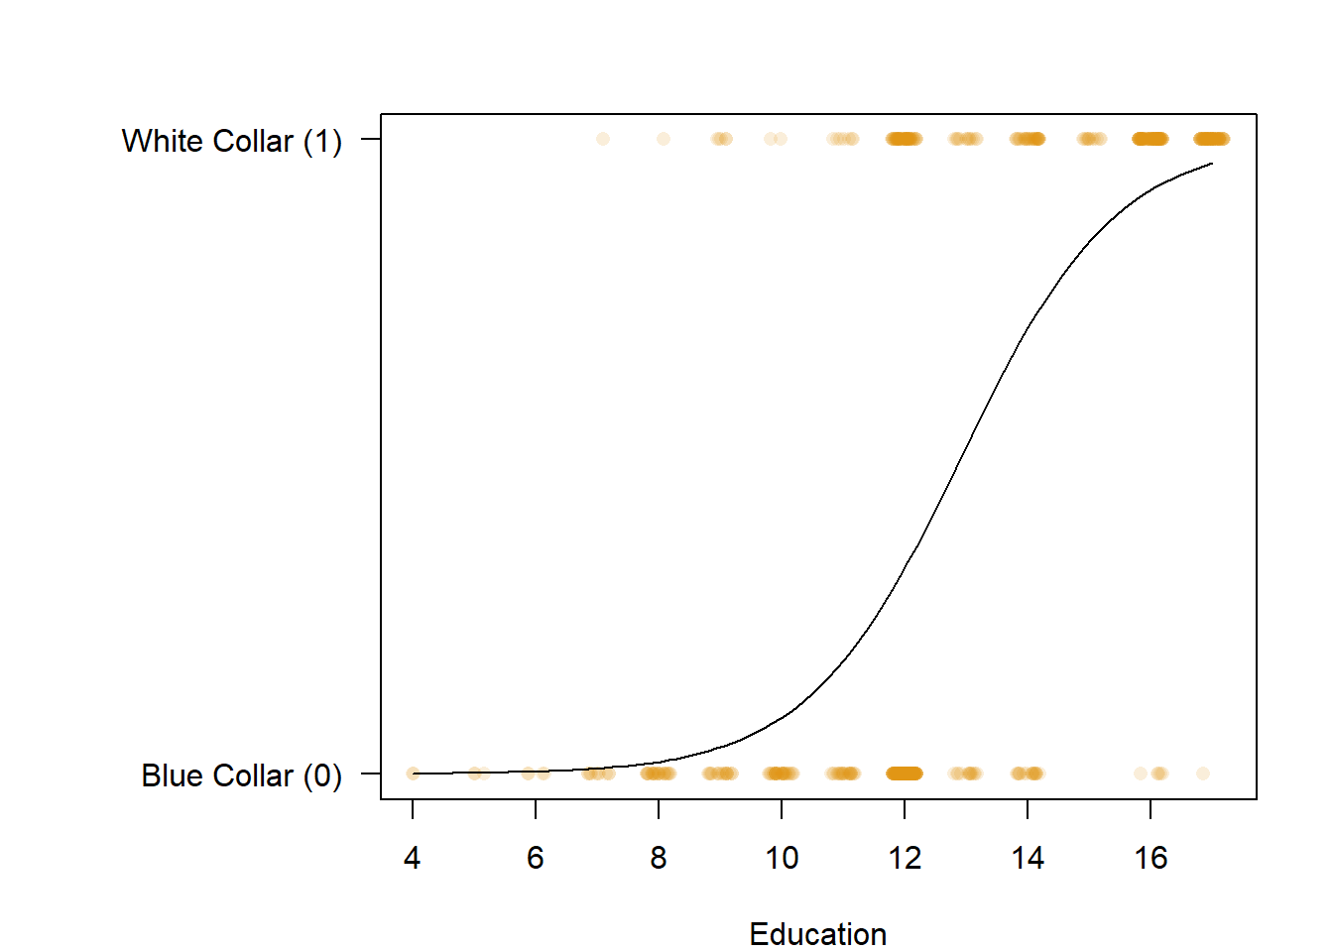
Predicting Probability with Logistic Regression (1)
Similar to linear regression, but the target variable is binary.

Slide 20
Predicting Probability with Logistic Regression (2)
Fits an S-shaped (sigmoidal) curve to the data.
The point on the curve represents a probability.
E.g. on previous slide, if a new sample has education=8, the probability of being “white collar” is low, whereas with 14, it’s high, but with 13, it’s around 0.5.
Can be used for classification very simply. In the previous simple example, if probability<0.5, classify as 0, otherwise classify as 1.

Slide 21
Predicting Probability with Logistic Regression (3)
from sklearn.linear_model import LogisticRegression
LR = LogisticRegression(random_state=0)
LR.fit(features, targets)
To calculate the probabilities:
probabilities = LR.predict_proba(testFeatures)
To classify (as normal):
predictions = LR.predict(testFeatures)

Slide 22
What we’ve covered today…
Built-in datasets.
Data from a file.
Splitting the data.
Using an ML model.
Classification accuracy.
Regression accuracy.
Making new predictions.
Obtaining data and reading CSVs.
Multi-layer Perceptrons.
Probability with logistic regression.

